Slide 1

Arcaninjadroid: Kitty Catastrophe
Pitch date: June 3rd 2018

Slide 2

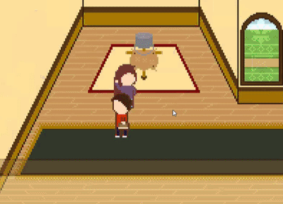
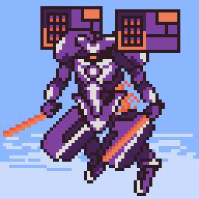
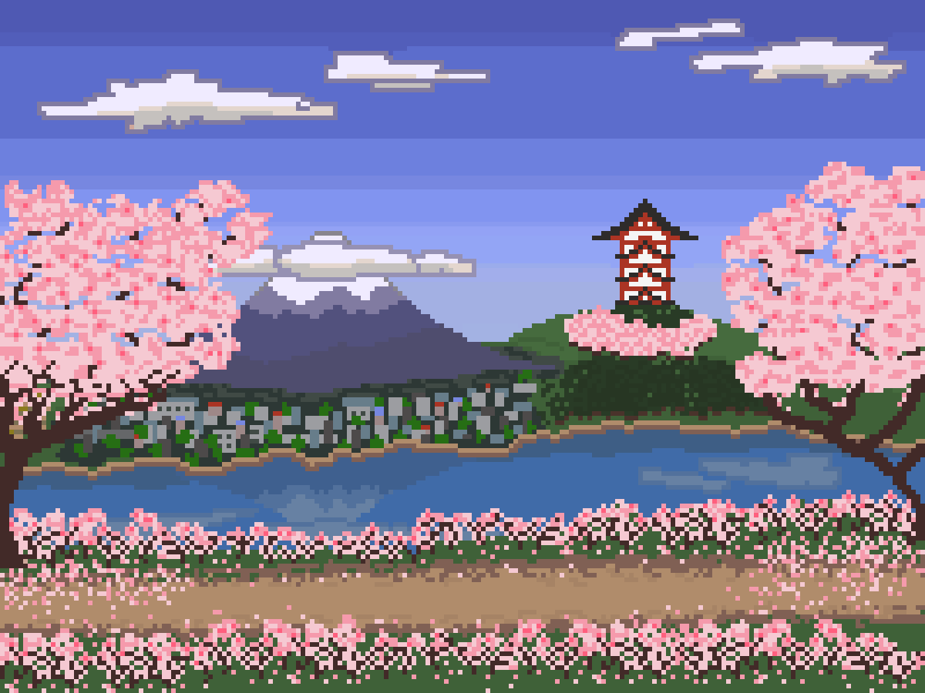
Who am I?
Led Spell Spiel during Summer 2017
Helped out on various club projects since, and other personal endeavours
Physics and CS by day, resident pixel artist by night

Slide 3
We’re making…
A side-scrolling action beat’em up!

Slide 4

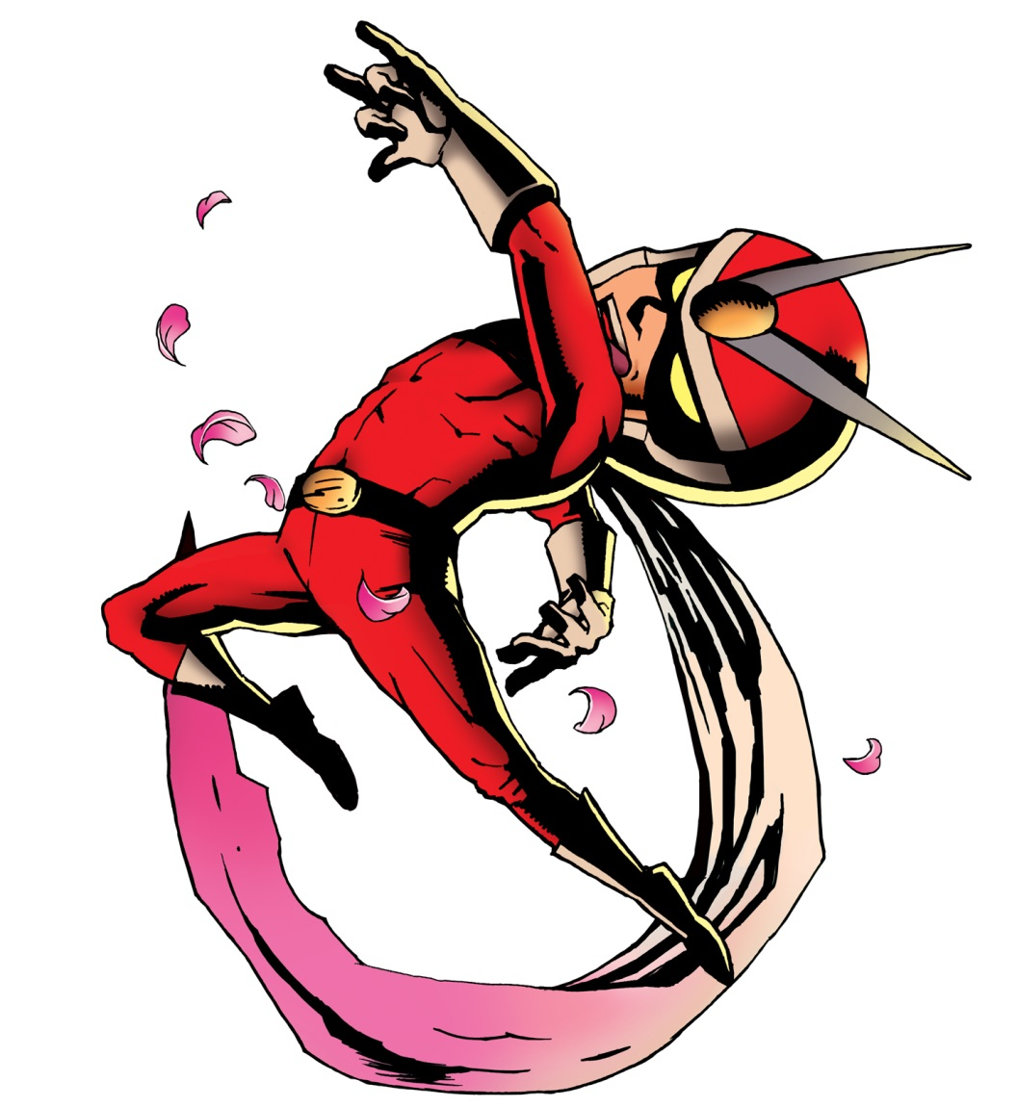
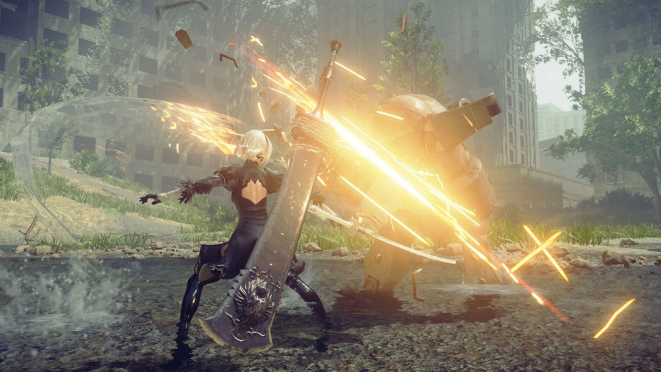
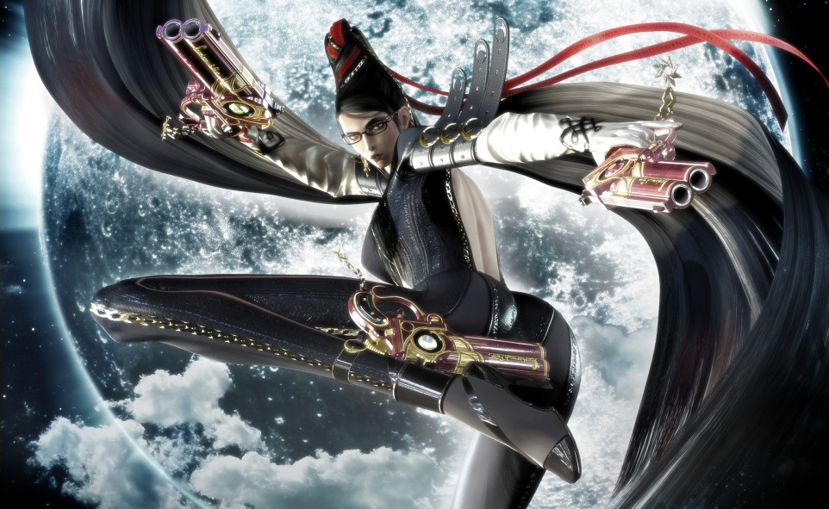
The inspiration
Early to current day Platinum Games
Focus on action and fluid, stylish combat

Slide 5
The basics
Javascript/HTML5 on Canvas
Pixelated style
3 months (until end of August)
Story/concept TBD
Objective: reach the end, beat the boss, save Kitten!
Gameplay around ground + air combos, dodging and parrying.

Slide 6
The story
Aliens have arrived on Earth
They’ve agreed to leave forever, in exchange for most of Earth’s kittens
Refusing to surrender your friend, you spent 8 years mastering ninja techniques, learning the magical arts, and augmenting yourself with robotic parts. The first Arcaninjadroid. Now, you must rescue Kitten!!!

Slide 7
Demo time!!!

Slide 8

The main challenges
Animating humans. I’ve been practicing in prep for this.
Fluid, satisfying gameplay. Will need help with gameplay design and handling complex inputs.
What you can do:
Environment creation
Minimalistic UI: combo counter and HP bar
Enemy design, art, implementation etc.
Animation: difficulty will vary a lot!
SFX: many kicks will be received in the face!
Action music!!! :D
If you’re up to the challenge: help me with the gameplay code. There is much advanced coding (state machines, animation, tricky collision detection and more) we can figure out together! :D

Slide 9
Schedule

Slide 10

Questions?

